Slide 1
OPERATING SYSTEM CONCEPTS
操作系统概念
张 柏 礼
bailey_zhang@sohu.com
东南大学计算机学院

Slide 2
2. Operating-System Structures
Objectives
  To describe the services that an operating system provides to users, processes, and other systems
  To discuss the various ways of structuring an operating system
  To explain how operating systems are installed and customized and how they boot

Slide 3
2. Operating-System Structures
2.1 Operating System Services
2.2 User Operating System Interface
2.3 System Calls
2.4 Types of System Calls
2.4 System Programs
2.6 Operating System Design and Implementation
2.7 Operating System Structure
2.8 Virtual Machines
2.9 Operating System Generation
2.10 System Boot

Slide 4
2.1 Operating System Services
Generally operating-system should provide one set of common services （that are helpful to the user）
  User interface (UI)
    Almost all operating systems have a user interface
    Command-Line interface (CLI)
    Graphics User Interface (GUI)
    Batch Interface
      Commands and directives are entered into files, and those files are executed

Slide 5
2.1 Operating System Services
  Program execution
    The system must be able to
      load a program into memory
      run that program
      end execution, either normally or abnormally (indicating error)
  I/O operations
    A running program may require I/O, which may involve a file or an I/O device
    The operating system must provide a means to operate I/O

Slide 6
2.1 Operating System Services
  File-system manipulation
    read and write files and directories
    create and delete
    search
    List
    permission management
  Communications
    Processes may exchange information, on the same computer or between computers over a network
    Communications may be via shared memory or through message passing (packets moved by the OS)

Slide 7
2.1 Operating System Services
  Error detection
    OS needs to be constantly aware of possible errors
      Errors may occur in the CPU and memory hardware, in I/O devices, in user program
    For each type of error, OS should take the appropriate action to ensure correct and consistent computing
    Debugging facilities can greatly enhance the user’s and programmer’s abilities to efficiently use the system

Slide 8
2.1 Operating System Services
Operating-system provide another set of common services （that are helpful to ensuring the efficient operation of the system itself ）
  Resource allocation
    When multiple users or multiple jobs running concurrently
    Resources must be allocated to each of them
      Some may have special allocation code
        such as CPU cycles (process-scheduling), main memory, and file storage
      others may have general request and release code
        such as I/O devices

Slide 9
2.1 Operating System Services
  Accounting （登账）
    To keep track of which users use how much and what kinds of computer resources
  Protection and security
    Protection involves ensuring that all access to system resources is controlled
    Security requires user to authenticate himself to the system, extends to defending external I/O devices from invalid access attempts

Slide 10

2.1 Operating System Services

Slide 11
2. Operating-System Structures
2.1 Operating System Services
2.2 User Operating System Interface
2.3 System Calls
2.4 Types of System Calls
2.4 System Programs
2.6 Operating System Design and Implementation
2.7 Operating System Structure
2.8 Virtual Machines
2.9 Operating System Generation
2.10 System Boot

Slide 12
2.2 User Operating System Interface
Command Line Interface (CLI)
  Command interpreter（解释器）
  allows directly to enter command entry
    The main function to fetch a command from user and executes it
  Some are implemented in kernel
  some are treated as a special system program
    Shells
      multiple flavors implemented
        csh, bsh,ksh
      Provide similar functionality with little differences

Slide 13
2.2 User Operating System Interface
  Two general type of command to implement
    commands built-in
      the interpreter contains the code to execute the command
    just name of program
      the interpreter just use command to identify an executable file to be loaded to memory and executed
        For example, in UNIX, “rm file.txt”, “rm” is an executable file
        adding new features doesn’t require shell modification

Slide 14
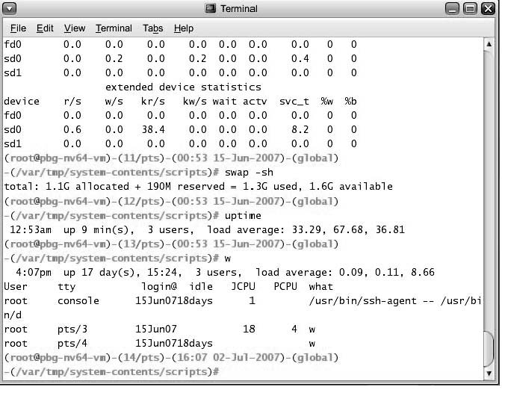
2.2 User Operating System Interface

Slide 15
2.2 User Operating System Interface
GUI
  Provide a mouse-based window-and-menu system as an interface
    Provides desktop metaphor
    Images or icons on the desktop represent programs, file, system function,……
    Clicking a button on the mouse can invoke a program, select a file or directory or pull down a menu
  Developing history
    Invented at Xerox PARC
    Apple Macintosh computer
    Windows
    UNIX: CDE, X-window,
    KDE, GNOME—open source

Slide 16
2.2 User Operating System Interface
  GUI typically is removed from the system structure, its design is therefore not a direct function of the operating system
Many systems now include both CLI and GUI interfaces
    Microsoft Windows is GUI with CLI “command” shell
    Apple Mac OS X as “Aqua” GUI interface with UNIX kernel underneath and shells available
    Solaris is CLI with optional GUI interfaces (Java Desktop, KDE)

Slide 17

2.2 User Operating System Interface

Slide 18
2. Operating-System Structures
2.1 Operating System Services
2.2 User Operating System Interface
2.3 System Calls
2.4 Types of System Calls
2.4 System Programs
2.6 Operating System Design and Implementation
2.7 Operating System Structure
2.8 Virtual Machines
2.9 Operating System Generation
2.10 System Boot

Slide 19
2.3 System Calls
Definition
  Programming interface to the services provided by the OS
    Typically written in a high-level language (C or C++)
    Few low-level routines may need to be written in assembly-language instructions
  Example
    read data from a file and copy them to another file
    Require a sequence of system call
      Get the names of files, Open the input file and create the output file
      Error output and terminate program abnormally
      program to abort
      Replace the existing file, then read , write and close files

Slide 20

2.3 System Calls
System call sequence to copy the data of one file to another file

Slide 21
2.3 System Calls
  Even very simple program may make heavy use of system call
    Systems often execute thousands of system calls per second
    Most users or programmers never see this level of detail
    Normally application developers design program according to an API rather than direct system call use

Slide 22
2.3 System Calls
Application Program Interface (API)
  Specify a set of functions that are available to an application programmer
    Passing parameters
    Returning the results
    。。。
  The most common APIs
    Win32 API, for windows system
    POSIX API, for UNIX/Linux/MacOS X
    JAVA API, for JAVA virtual machine

Slide 23
2.3 System Calls
API and system call
  API typically invoke the actual system calls on behalf of the application programmer
    CreateProcess() call NTCreateProcess()
  Why use APIs rather than system calls?
    Portability / compatibility : program based on API can be compiled and run on any different system that supports the same API
    Simplicity / availability: API can be used more easily than system call

Slide 24

2.3 System Calls
  An example
    ReadFile() function in the Win32 API

Slide 25
2.3 System Calls
    A description of the parameters passed to ReadFile()
      HANDLE file—the file to be read
      LPVOID buffer—a buffer where the data will be read into and written from
      DWORD bytesToRead—the number of bytes to be read into the buffer
      LPDWORD bytesRead—the number of bytes read during the last read
      LPOVERLAPPED ovl—indicates if overlapped（异步） I/O is being used

Slide 26
2.3 System Calls
  system call interface
    Provided by Run-time support system
      Serve as a link between system call and API
        Typically a number is assigned to a system call
        Maintain a table indexed according to these numbers
      Intercepts the function calls in API， then invokes the system call in the operating system and returns status of the system call and any return values
        The caller just need to obey the API and understand what the OS do
        Most the implement details are hidden by API and system call interface
Notes:
Provides a system call interface
API的实现库 系统调用的封装 只是 API的一部分，API 还包括其他函数库
A set of function built into libraries included with a compiler----相当于 静态链接库或动态链接库（API的实现）---用户用的仅仅是API的名称
system call interface—接口
a number : system call no 类似于中断向量表
intercept [,intə'sept]拦截

Slide 27

2.3 System Calls
API layer
System call layer

Slide 28
2.3 System Calls
    Passing parameters
      Often more information is required than simply the identity of desired system call
        exact type and amount of information vary according to OS and call
      Three general methods
      1) Simplest: pass the parameters in registers
        In some cases, may be more parameters than registers
      2) Parameters stored in a block or table in memory, and address of block passed as a parameter in a register
        This approach taken by Linux and Solaris

Slide 29
2.3 System Calls
      3) Parameters can be placed, or pushed, onto the stack by the program and popped off the stack by the operating system
    Block and stack methods do not limit the number or length of parameters being passed

Slide 30

2.3 System Calls

Slide 31
2. Operating-System Structures
2.1 Operating System Services
2.2 User Operating System Interface
2.3 System Calls
2.4 Types of System Calls
2.4 System Programs
2.6 Operating System Design and Implementation
2.7 Operating System Structure
2.8 Virtual Machines
2.9 Operating System Generation
2.10 System Boot

Slide 32
2.4 Types of System Calls
Five major categories
  （1）Process control
    (normally) end, (abnormally) abort
    Load, execute the program
    Create and terminate process
    Get/set process attribute
    Wait for time / event, signal event
    Allocate and free memory
  （2）File manipulation
    Create and delete file
    Open and close file
    Read, write and reposition file
    Get / set file attributes

Slide 33
2.4 Types of System Calls
  （3）Device manipulation
    Request / release device
    Read, write and reposition device
    Get / set device attributes
    Logically attach / detach device
  （4）Information maintenance
    Get/set time or date
    Get/set system data
    Get/set process/file/device attribute

Slide 34
2.4 Types of System Calls
  （5）Communications
    Create/ delete communication connection
    Send/ receive message
    Transfer status information
    Attach / detach remote device
Examples of Windows and Unix System Calls

Slide 35

2.4 Types of System Calls

Slide 36

2.4 Types of System Calls
Example of MS-DOS execution
(a) At system startup (b) running a program

Slide 37
2.4 Types of System Calls
  MS-DOS is a single-tasking system
  Command interpreter
    is invoked when the computer is started
    It uses simple method to run a program, no create a new process
      Load the program into memory, write out most of itself to give the program as much memory as possible
      Put the instruction pointer to the first instruction of the program
    After program ended or aborted
      The command interpreter resumes execute
      Reload the rest of the command interpreter from disk

Slide 38
2.4 Types of System Calls
Example of FreeBSD Running Multiple Programs
  Is a multitasking system, derived from Berkeley UNIX
  When a user log on, the shell (command interpreter) is run
  To start a new process
    The shell executes a fork()
    Then the selected program is loaded into memory via an exec()
    The shell is still running
      Wait for the process to finish
      Or
      Run in the background for receiving new command

Slide 39
    int main()
    {
    pid_t pid;
    pid = fork(); /* fork another process */
    if (pid < 0) { /* error occurred */
    fprintf(stderr, "Fork Failed");
    exit(-1);
    }
    else if (pid == 0) { /* child process */
    execlp("/bin/ls", "ls", NULL);
    }
    else { /* parent process */
    wait (NULL);/* parent will wait for the child to complete */
    printf ("Child Complete");
    exit(0);
    }
    }

Slide 40

2.4 Types of System Calls

Slide 41
2. Operating-System Structures
2.1 Operating System Services
2.2 User Operating System Interface
2.3 System Calls
2.4 Types of System Calls
2.5 System Programs
2.6 Operating System Design and Implementation
2.7 Operating System Structure
2.8 Virtual Machines
2.9 Operating System Generation
2.10 System Boot

Slide 42
2.5 System Programs
System programs provide a convenient environment for program development and execution.
  Some of them are simply user interface to system calls
  Others can be looked as system tools to finish a set of complex system functions.
System programs can be divided into:
  >File manipulation
    Create, delete, copy, rename, print, dump, list, and generally manipulate files and directories
  >File modification/editor
    Text editors to create and modify files
    Special commands to search contents of files or perform transformations of the text

Slide 43
2.5 System Programs
  >Status information
    Some ask the system for info - date, time, amount of available memory, disk space, number of users
    Others provide detailed performance, logging, and debugging information
    Typically, these programs format and print the output to the terminal or other output devices
    Some systems implement a registry - used to store and retrieve configuration information
  >Programming language support
    Compilers, assemblers, debuggers and interpreters sometimes provided

Slide 44
2.5 System Programs
  >Program loading and execution
    Absolute loaders, re-locatable loaders, linkage editors, and overlay-loaders
    debugging systems for higher-level and machine language
  >Communications
    Provide the mechanism for creating virtual connections among processes, users, and computer systems
    Allow users to send messages to one another’s screens, browse web pages, send electronic-mail messages, login remotely, transfer files from one machine to another

Slide 45
2.5 System Programs
  >System utilities and application programs
    Is supplied to work with OS in solving common problems or operation.
    Examples
      Web browsers
      Word processors
      Spreadsheets
      Database system
      Compiler
      game
Most users’ view of the operating system is defined by system programs or application programs, not the actual system calls

Slide 46
2. Operating-System Structures
2.1 Operating System Services
2.2 User Operating System Interface
2.3 System Calls
2.4 Types of System Calls
2.5 System Programs
2.6 Operating System Design and Implementation
2.7 Operating System Structure
2.8 Virtual Machines
2.9 Operating System Generation
2.10 System Boot

Slide 47
2.6 OS Design and Implementation
Design goals
  At the highest level, design is affected by the choice of
    Hardware
    Type of system
      Batch, time share, real time, distributed
      Single user, multi-user
      General-purpose, special-purpose
  Beyond the highest design level, the requirements are much harder to specify, but it can be divided into :
    User goals
    System goals
Notes:
在最高的设计层次上看，需求是很难确定的。但从最终的目标看

Slide 48
2.6 OS Design and Implementation
    User goals
      Convenient to use
      Easy to learn and use
      Reliable, safe, and fast
    System goals
      Easy to design, implement, and maintain
      Flexible, reliable, error free and efficient
    Those requirement
      Is vague and can be interpreted in various way
      Not specify how to achieve
      Is not useful in the design

Slide 49
2.6 OS Design and Implementation
    No unique solution to the problem of defining the requirement .
      It is highly creative task
      General principles is developed in the field of software engineering

Slide 50
2.6 OS Design and Implementation
Policy (基本原则) and Mechanism(具体方案)
  It is important to separate policy from mechanism
    it allows maximum flexibility if policy decisions are to be changed later

Slide 51
2.6 OS Design and Implementation
  Policy： What will be done? （目标）
    Change across places or over time
    Example: give I/O-intensive program higher priority over CPU-intensive programs, or opposite
  Mechanism: How to do it? （具体实现）
    Is insensitive to changes in policy
    Example: mechanism for giving priority to certain types of program over others
    （并不写死--固化于代码：I/O密集型的任务高于CPU密集型）

Slide 52
2.6 OS Design and Implementation
  Example ：Microkernel OS
    Implement a basic of primitive building blocks
    These blocks are almost policy free
    Allow more advanced mechanisms and policies to be added via user-created kernel modules or via user program themselves.
Notes:
policy free 具体实现/方案 无关 只知道干活，不管为谁干活，谁发工资就给谁干。 上有政策下有对策
kernel ['kə:nl] primitive['primitiv]
An example 核很小，功能外加
At first, UNIX had a time-sharing
In the latest version of solaris
Depending on loadable tables, the system can be time shared, batch processing, real time, fair share, or any combination
Making the scheduling mechanism general purpose allows vast policy changes

Slide 53
2.6 OS Design and Implementation
  Opposite example： Windows
    Both mechanism and policy encoded in the system to enforce a global look and feel
    All applications have similar interfaces, because the interface itself is built into the kernel and system libraries.

Slide 54
2.6 OS Design and Implementation
Implementation
  Traditionally, operating systems have been written in assemble language
  Now, most are written in higher-level language such as C/C++
  The advantage of higher-level language
    Is written fast
    Is more compact
    Is easier to understand and debug
    Is convenient to migrate

Slide 55
2.6 OS Design and Implementation
  The disadvantage of higher-level language
    Reduce speed
      solution
        Improvement in compiler technology will produce excellent code
        Bottleneck routine can be identified and can be replaced with assemble code
    Increase storage requirement
  Better data structures and algorithms are likely more important than using excellent assemble-language code

Slide 56
2. Operating-System Structures
2.1 Operating System Services
2.2 User Operating System Interface
2.3 System Calls
2.4 Types of System Calls
2.4 System Programs
2.6 Operating System Design and Implementation
2.7 Operating System Structure
2.8 Virtual Machines
2.9 Operating System Generation
2.10 System Boot

Slide 57
2.7 Operating System Structure
1.Simple Structure
  Many commercial system do not have a well-defined structure
    They started as small, simple, and limited systems
    Grew beyond their original scope
  A example—MS-DOS
    It was written to provide the most functionality in the least space
    Not divided into modules
    The designers had no idea that it would become so popular at all

Slide 58

2.7 Operating System Structure

Slide 59
2.7 Operating System Structure
  another example—original UNIX
    Consists of two separable parts:
      the kernel
      the system programs
    Enormous amount of functionality to be combined into one level
    This monolithic structure （庞大的单片结构） was difficult to implement and maintain

Slide 60


2.7 Operating System Structure
2.Layered Approach
  The operating system can be divided into a number of layers (levels)
    each layers built on top of lower layers.
    The bottom layer (layer 0), is the hardware
    the highest (layer N) is the user interface.

Slide 61
2.7 Operating System Structure
  A typical layer consists of data structure and a set of routines
    Its routines can be invoked by higher-level
    It can invoke operation on lower-level layers
  Advantage: Simplicity of construction and debugging
    Each layer uses the functions and services of only lower-level layers
      It simplifies debugging and system verification
    Each hides the existence of certain data structures, operation and hardware from higher-level layers
      It does not need to know how these operations are implemented

Slide 62
2.7 Operating System Structure
  Disadvantage 1: definition of the various layers is difficult
    a layer can use only lower-level layers, it makes planning is very difficult sometime
      Memory management requires the ability to use the backing store(对换), so device driver for the backing store must be at lower level than the memory management
      the backing store needs CPU scheduler, so it would be above the CPU scheduler. But the CPU scheduler may have more information, and those information may need to be swapped in and out of memory, so it needs to invoke the backing store
    Main difficulty with the layer approach

Slide 63
2.7 Operating System Structure
  Disadvantage 2: less efficient
    When a user program executes an I/O operation
    At each layer, the parameters may be modified, data may need to be passed, and so on
    Each layer adds overhead to the system call
    It causes the system call taking longer time

Slide 64
2.7 Operating System Structure
3.Microkernel Approach
  Mach using microkernel approach
  Removing all nonessential components from the kernel and implementing them as system and user-level programs
    Which service should remain in kernel？
    Which should be implemented in user space？
  Typically, microkernel provides
    Minimal process and memory management
    Basic Communication
      For the client program and the various services that are also running in user space
      Is provided by message passing

Slide 65
2.7 Operating System Structure
  Benefits:
    Easier to extend a microkernel
      All new services are added to user space without modification of the kernel
      When kernel has to be modified, the changes is few
    Easier to port the operating system to new architectures
    More security and reliability
      less code is running in kernel mode

Slide 66
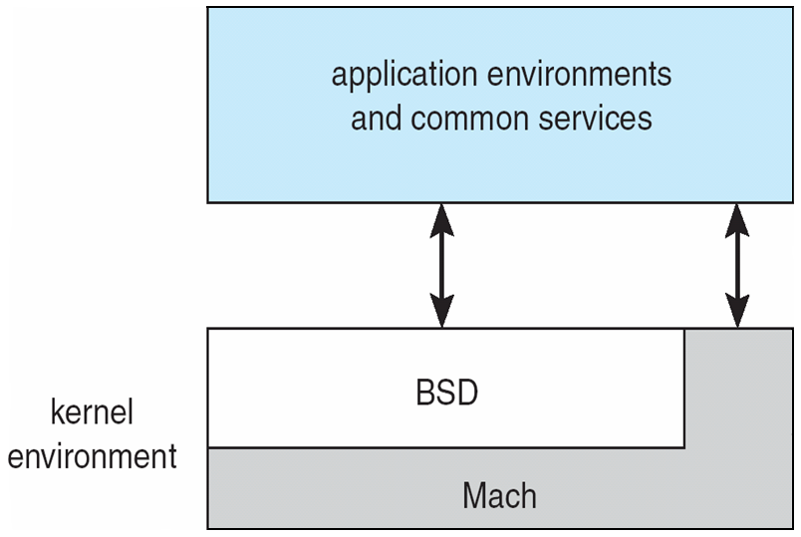
2.7 Operating System Structure
  Detriments(危害):
    Performance decreases due to
      increased system function overhead
      increased communication between user space and kernel space
    Examples:
      Earlier versions of Windows NT
      XP: Monolithic
      Mac OS X (Hybrid:Micro + layered / Modules)

Slide 67

2.7 Operating System Structure
4.Modules Approach
  Perhaps be the best current approach
  Uses object-oriented approach to create a module kernel
  The kernel has a set of core components and dynamical links in additional services

Slide 68
2.7 Operating System Structure
  Uses dynamical loadable modules
    When needed, any component can be added to the kernel
  similar to layers but with more flexible
    Can call any other module
  similar to microkernel but more efficient
    Communication don’t need to invoke message passing
  Be common in most modern operating systems implementation
      UNIX，Linux，MacOS X

Slide 69
2. Operating-System Structures
2.1 Operating System Services
2.2 User Operating System Interface
2.3 System Calls
2.4 Types of System Calls
2.4 System Programs
2.6 Operating System Design and Implementation
2.7 Operating System Structure
2.8 Virtual Machines
2.9 Operating System Generation
2.10 System Boot

Slide 70
2.8 Virtual Machines
Concept
  Is the logical conclusion of the layered approach
    treats hardware and the operating system kernel as a layer（as though they were all hardware）
    virtual machines provides an interface identical to the underlying bare hardware
Notes:
of the layered approach
execution environments：java or windows or linux （一个JAVA程序对应一个JVM ？）

Slide 71
2.8 Virtual Machines
  Abstracts/Simulates the hardware of a single computer into several different execution environments
    Creating the illusion that each separate execution environment is running its own private computer
    Further, by using CPU scheduling and virtual memory, OS can provide the illusion that
      Each process is provided with a (virtual) copy of underlying computer
      each executing on its own processor with its own (virtual) memory and its own virtual disk (minidisk)
    Users are given their own virtual machines, on it
      Can run any of the OS or software packages that are available on the underlying machine

Slide 72

2.8 Virtual Machines
(a) Nonvirtual machine (b) virtual machine

Slide 73
2.8 Virtual Machines
The virtual machine concept is difficult to implement due to
  The effort required to provide an exact duplication to the underlying machine
  User mode and kernel mode
Benefits of virtual machine
  Being able to share the same hardware yet run several different execute environments concurrently

Slide 74
2.8 Virtual Machines
  provides complete protection of system resources
    each virtual machine is isolated from all other virtual machines
    however, there is no direct sharing of resources between different VM.
    how to share resources
      Share a minidisk for VMs (implemented by software)
      Define a network of virtual machines over which VMs can send information to other VM
  A virtual-machine system is a perfect vehicle for operating-systems research and development.
    System development is done on the virtual machine
    instead of on a physical machine
    not disrupt normal system operation.

Slide 75
2.8 Virtual Machines
Examples
  VMware Architecture
    First appeared commercially in IBM mainframes in 1972
    Abstracts Intel 80X86 hardware into isolated virtual machines
    VMware runs as an application on host OS
    Allows this host OS to concurrently run several different guest OS
  VirtualBOX
Notes:
模拟了多个裸机

Slide 76
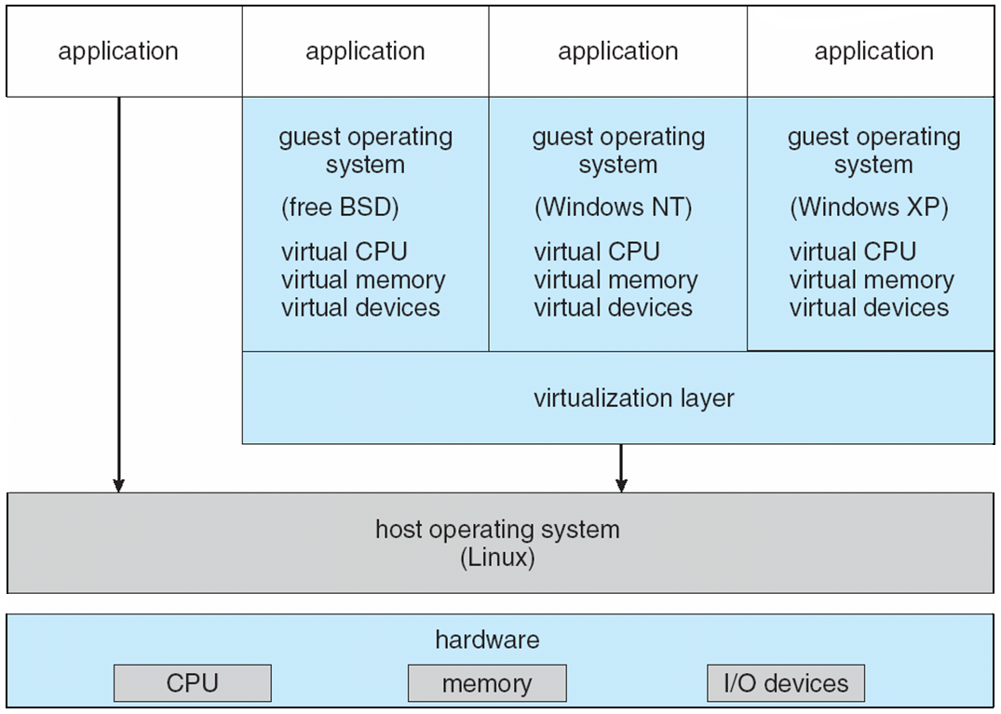
2.8 Virtual Machines

Slide 77
2.8 Virtual Machines
Java virtual machine（JVM）
  Java
    Is a language specification
      A Java program is consists of one or more classes
      The java compiler compiles java classes to an architecture-neutral bytecode file
      The bytecode file can run on JVM
    Is a larger API library
    Provides a specification for JVM
      JVM is a specification for an abstract computer, it consists of
        A class loader: it loads the compiled .class files
        A Java interpreter：it executes the bytecode
      Just-In-Time (JIT) compilers increase performance

Slide 78
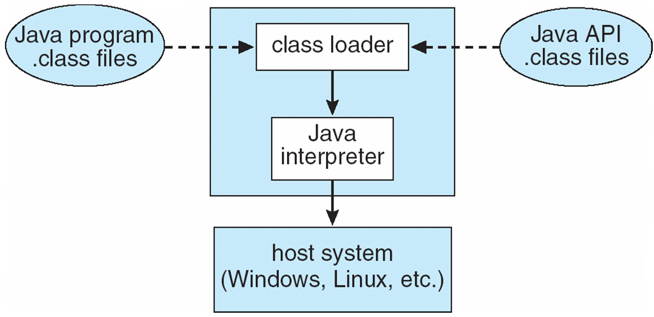
2.8 Virtual Machines

Slide 79
2. Operating-System Structures
2.1 Operating System Services
2.2 User Operating System Interface
2.3 System Calls
2.4 Types of System Calls
2.4 System Programs
2.6 Operating System Design and Implementation
2.7 Operating System Structure
2.8 Virtual Machines
2.9 Operating System Generation
2.10 System Boot

Slide 80
2.9 Operating System Generation
SYSGEN
  Operating systems are designed to run
    on any of a class of machines
    at a variety of sites
    With a variety of peripheral configurations

Slide 81
2.9 Operating System Generation
  For each specific computer site, the operation system must be configured by a process known as system generation (SYSGEN)
    SYSGEN program reads a given file or asks the operator of system
    To obtains information concerning the specific configuration of the hardware system
      What CPU is used?
      How much memory is available？
      What devices are available?
      What operating-system options are desired, or what parameter values are to be used?

Slide 82
2.9 Operating System Generation
    Methods of generation
      A） to modify a copy of the source of the operating system, and to compile it completely
      B）to create tables and to select modules from a precompiled library, then links those modules to form the operating system
      C）to construct the system table-driven completely . All code is the part of the system, selection occurs at run-time, rather than at compile or link time.
        Solaris
        Windows 2000/XP
      The major difference of above three ways
        The size and generality of the generated system
        The ease of modification as the hardware configuration changes
Notes:
Runtime: 安装系统时进行选择

Slide 83
2. Operating-System Structures
2.1 Operating System Services
2.2 User Operating System Interface
2.3 System Calls
2.4 Types of System Calls
2.4 System Programs
2.6 Operating System Design and Implementation
2.7 Operating System Structure
2.8 Virtual Machines
2.9 Operating System Generation
2.10 System Boot

Slide 84
2.10 System Boot
Booting the system
  Operating system must be made available to hardware so hardware can start it
    Hardware need to know where the kernel is or how to load the kernel
    Bootstrap program / bootstrap loader – code stored in ROM/EPROM that is able to locate the kernel, load it into memory, and start its execution
  Procedure of starting the system by loading the kernel is known as booting the system
    On most systems, bootstrap loader, locates the kernel, loads it into memory, and starts it
    Other system such as PCs, bootstrap loader fetches a more complex boot program from disk, which loads the kernel.
Notes:
Booting – starting a computer by loading the kernel

Slide 85
2.10 System Boot
  The details procedure of booting
    When CPU is powered up or rebooted,
    the instruction register is loaded with a fixed memory location
      that is the address of the initial bootstrap program.
    And then continue with the booting steps
      Diagnose the computer
      Initialize the system, from CPU register to device control and the contents of main memory
      Start OS

Slide 86
2.10 System Boot
Firmware
  ROM / EPROM : used to hold initial boot code
    Executing code is slower than in RAM
    Is relatively expensive
  To small OS such as PDA, cellular phone
    Storing all in ROM
      Changing the bootstrap code need to replace the ROM chips
    Storing all in EPROM
  To large OS or the system that changes frequently
    bootstrap loader is stored in firmware (ROM/EPROM)
    OS is stored in disk

Slide 87
exercises
2.3
2.12
2.13

Slide 88
experiment
2.18 实验内容：
使用系统调用，用C或C++写一个程序，实现如下功能：从一个文件中读出数据，写入另一个文件中。
要求：
  具有良好的交互性
  使用者可输入源文件和目的文件的路径和文件名。
  具有完善的错误处理机制
  针对可能出现的各种错误，要有相应的错误提示输出，并作相应处理。
  在Linux操作系统上调试并运行
实验目的：
  通过实验，加深对系统调用概念的理解，了解其实现机制以及使用方式。
  通过在Linux操作系统上编写和调试简单程序，进一步熟悉Linux操作系统的使用，初步掌握linux环境下的C或C++编译和调试工具，为进一步理解和学习Linux操作系统的内核结构和核心机制作准备。

Slide 89
experiment
具体要求：
  程序应独立完成编写和调试，严禁抄袭和拷贝！
  完成实验内容后应提交助教验收并登记成绩。
  在完成实验内容后二周内提交纸质实验报告，实验报告格式见《操作系统实验报告规范》。
  4. 本次实验报告中，（5）、（6）和（7）项可省略，在（8）实验体会一项应包含以下内容：
  在你的程序中用到了哪些系统调用？这些系统调用的功能是什么？在Windows操作系统中与这些系统调用相对应的Windows32 API分别是什么？写出其函数原型。

Slide 90
experiment
《操作系统实验报告规范》
  操作系统实验报告应包含以下各部分：
    （1）基本信息：完成人姓名、学号、报告日期
    （2）实验内容
    （3）实验目的
    （4）设计思路和流程图
    （5）主要数据结构及其说明
    （6）源程序并附上注释
    （7）程序运行时的初值和运行结果
    （8）实验体会：实验中遇到的问题及解决过程、实验中产生的错误及原因分析、实验的体会及收获、对做好今后实验提出建设性建议等。

